Slide 1


FINLATCS
PROJECT - 1
Name – Suyash Patil
College – IIT Roorkee
Branch - Production and Industrial Engineering(MIED)

Slide 2
Executive Summary
The analysis demonstrates how value is created, concentrated, and scaled through data-driven decision-making across banking, digital marketing, and media platforms.
Banking insights show a risk-averse acquisition strategy, targeting financially stable and credit-disciplined customers, with low subscription rates highlighting the inherent difficulty of converting conservative financial products.
Digital marketing performance is highly concentrated, where a small set of banner formats, placements, and mid-week timing (especially Thursdays) drives most conversions and revenue, proving that precision beats spend.
Campaign success is driven by traffic quality and timing, not by lower cost, as the best-performing campaign excels due to superior placement and intent alignment.
Media platform growth is driven by content efficiency, not volume, with entertainment categories achieving massive scale through repeat consumption, while high-upload categories underperform in audience impact.
Creator and viewership growth is seasonal, saturated, and geographically concentrated, favoring large urban markets and early platform entrants.
Overall conclusion: Across industries, impact comes from targeting the right users, using the right formats, choosing the right channels, and acting at the right time—not from scale alone.

Slide 3

BANKING SECTOR

Slide 4
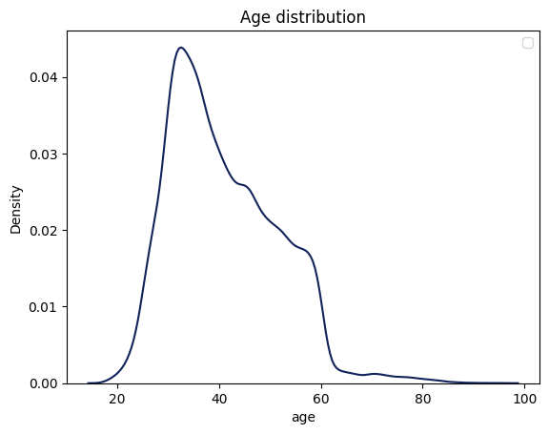
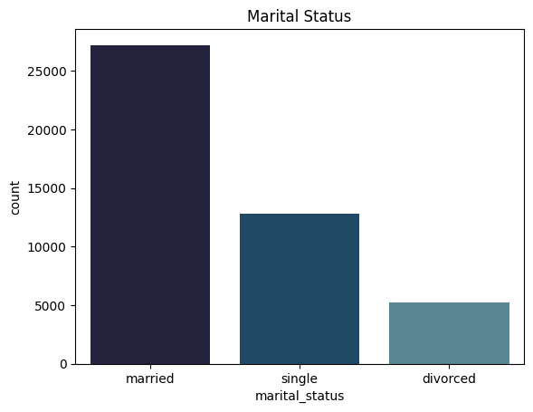
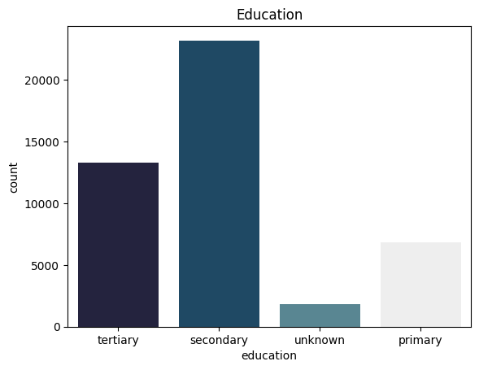
Married customers dominate the bank’s outreach, highlighting a strong focus on financially responsible, long-term planners who are more likely to prioritize savings and stability - especially during economic uncertainty.
Segment customers by marital status and tailor term-deposit offerings to align with life-stage financial priorities, maximizing conversion efficiency.
The bank’s outreach is heavily concentrated on customers in their prime earning and saving phase.
Senior citizens are under-targeted, likely due to lower campaign responsiveness and different financial needs.
The age distribution reflects a risk-aware marketing strategy, favoring financially active customers over capital-preserving ones.

Slide 5
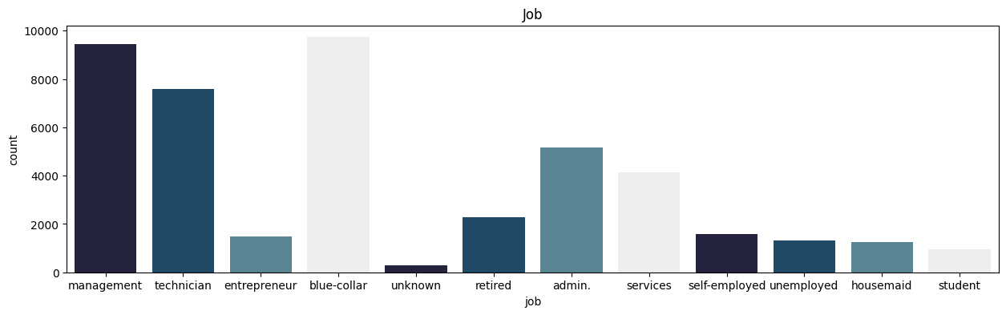
During the COVID-19 period, the bank largely focused its customer outreach on financially stable, salaried individuals—suggesting a conscious effort to reduce risk and improve the chances of successful conversions amid economic uncertainty.
The customer base is unevenly distributed, showing that the bank depends heavily on a small group of core occupational segments for most of its outreach :
This happens mainly due to :
Regular wages
Conservative financial behavior
Lower exposure to speculative investments
Blue-collar , Management customers form the largest group
One solution : Banks can design low-risk, medium-duration deposits for this segment

Slide 6
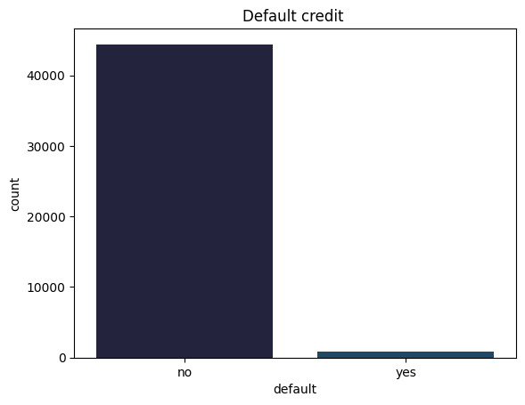
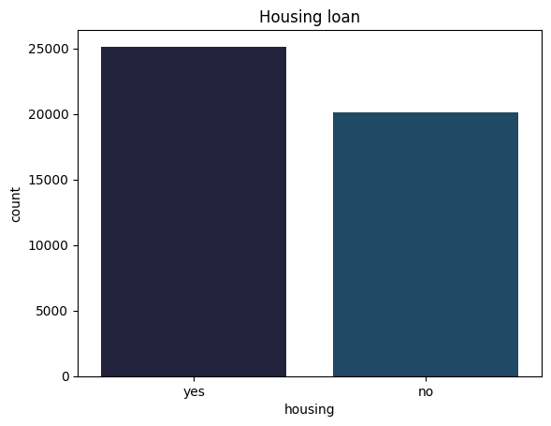
The bank deliberately targets customers with strong credit discipline, minimizing risk during uncertain economic conditions.
Customers with housing loans represent a financially committed but disciplined segment, indicating long-term planning and regular repayment behavior.
Overwhelming majority of customers have no credit default
Customers with a default history are extremely few
A large proportion of customers already have a housing loan
The split between “yes” and “no” is relatively balanced, with a slight dominance of loan holders

Slide 7
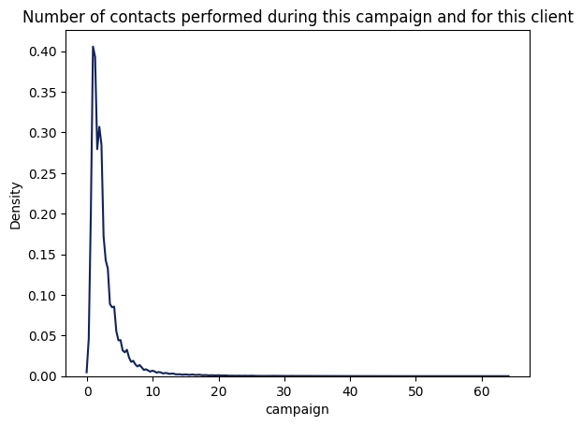
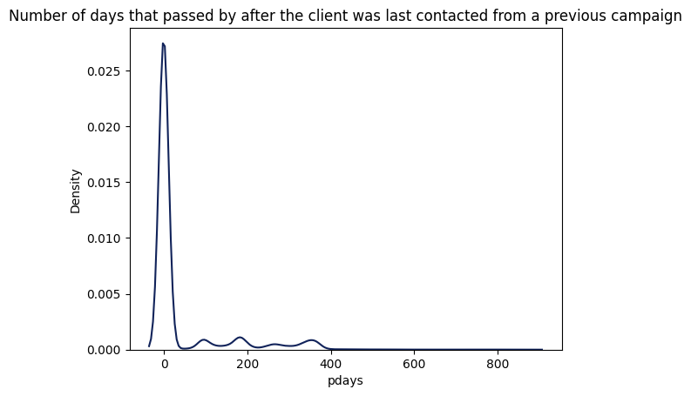
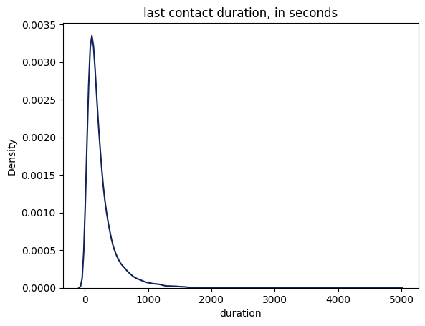
Number of days that passed by after client was last contacted from previous campaign
.
Customer contact activity is not uniform across the month and shows clear peaks around mid-month and month-end.
Very low contact density at the start of the month suggests missed outreach opportunities or deliberate campaign pacing.
May, June, July, and August dominate campaign activity, showing heavy concentration in late spring and summer.
Call durations are heavily right-skewed, with most calls ending very quickly.
Longer calls are rare but critical, as they indicate high engagement - however, duration is a post-event variable.
Customers with many prior contacts are extremely rare, indicating the bank avoids over-contacting the same individuals.
The campaign strategy is conservative, risk-aware, and engagement-driven - prioritizing fresh, financially stable customers with limited follow-ups while avoiding aggressive or repetitive contact behavior.

Slide 8
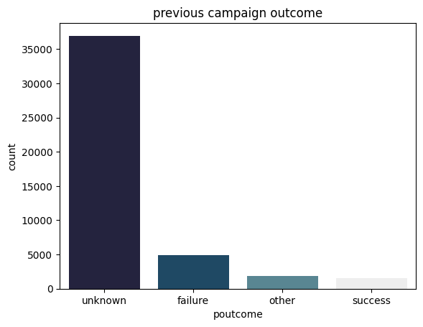
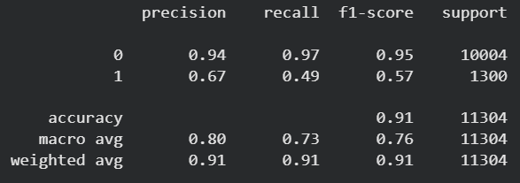
The overwhelming dominance of “unknown” previous outcomes indicates that the bank primarily targets customers with little or no prior campaign history, revealing a strong acquisition-focused strategy rather than reliance on repeat conversions.
Most customers have no prior campaign history, indicating acquisition-focused outreach.
Past successful customers are few but represent a high-value segment.
Real-time engagement matters more than historical outcomes.
A model was made on the given dataset predicting
subscription
Other insights :
A strong majority (84%) have no personal loan, indicating lower short-term debt burden.
Only 11.7% customers subscribed, confirming a highly imbalanced dataset.

Slide 9
DIGITAL - MARKETING

Slide 10
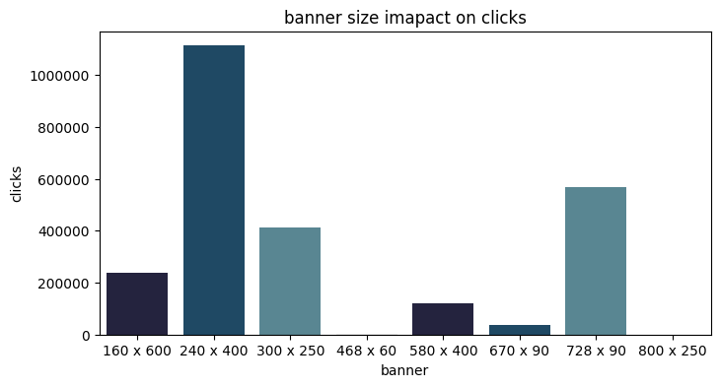
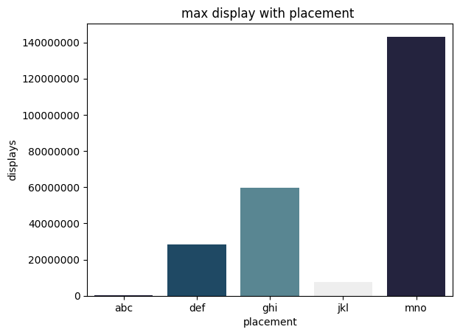
Most users fall into the Medium engagement category, indicating that campaigns are capturing attention but failing to strongly convert users into high engagement.
A small number of banner sizes generate a disproportionately high number of clicks, proving that creative format has a stronger influence on performance than sheer ad volume.
One placement overwhelmingly dominates ad visibility, showing that ad exposure is highly concentrated rather than evenly distributed across placements.
High click volume is concentrated in a small number of placements, indicating that user attention is highly location-sensitive rather than uniformly distributed across platforms.

Slide 11
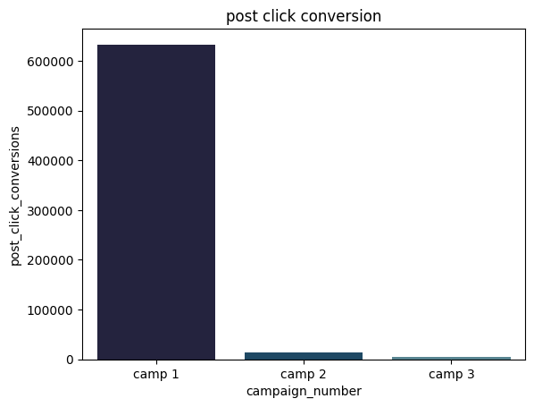
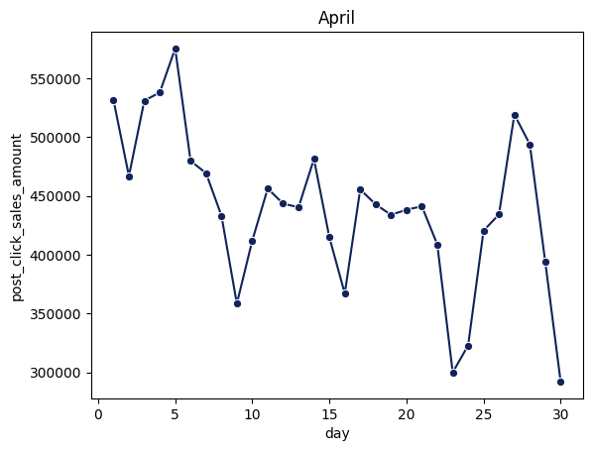
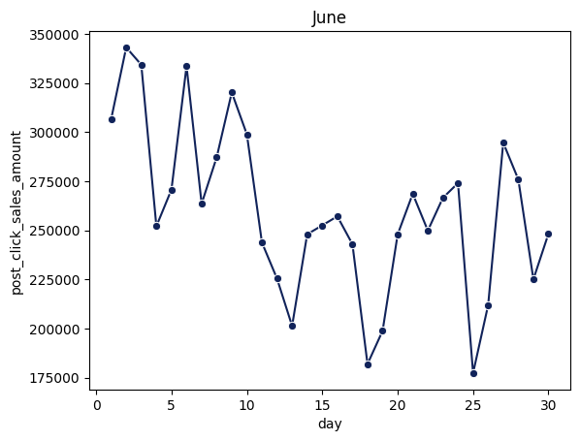
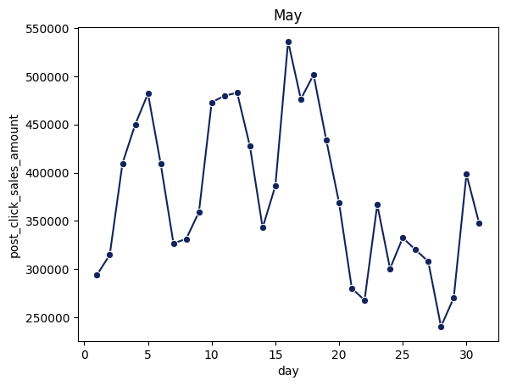
Campaign 1 outperformed because it combined high-performing banner formats, dominant placements, stronger user engagement, and optimal timing before audience fatigue set in.
Post-click sales show strong intra-month volatility, indicating that revenue is driven by short high-impact windows rather than steady daily performance.
There is a clear decline in average post-click sales from April to June, suggesting diminishing campaign effectiveness or market fatigue over time.
Even in strong months, revenue spikes are followed by sharp drops, highlighting dependence on a few high-performing days.

Slide 12
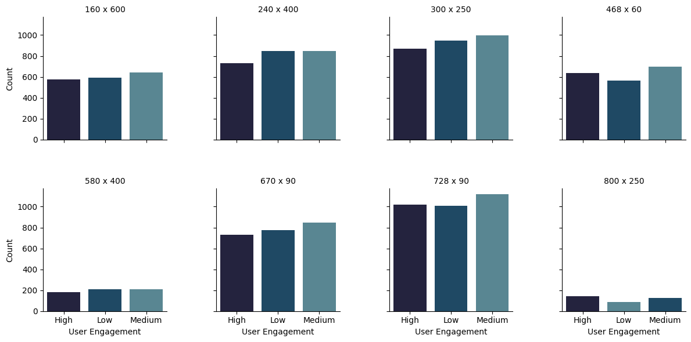
Across all banner sizes, medium user engagement consistently dominates, indicating that most creatives successfully capture attention but fail to convert it into strong engagement.
Standard banner formats such as 300×250 and 728×90 outperform other sizes across high, medium, and low engagement levels, making them the most reliable and scalable creative formats.
Larger banner sizes do not guarantee higher engagement, as several large formats show weak performance, proving that creative effectiveness matters more than screen size.
Engagement patterns remain stable and predictable across banner sizes, suggesting that user behavior is consistent and optimization should focus on creative quality rather than frequent format changes.
Overall, campaign performance can be significantly improved by standardizing high-performing banner sizes and enhancing creative content to shift users from medium to high engagement.

Slide 13
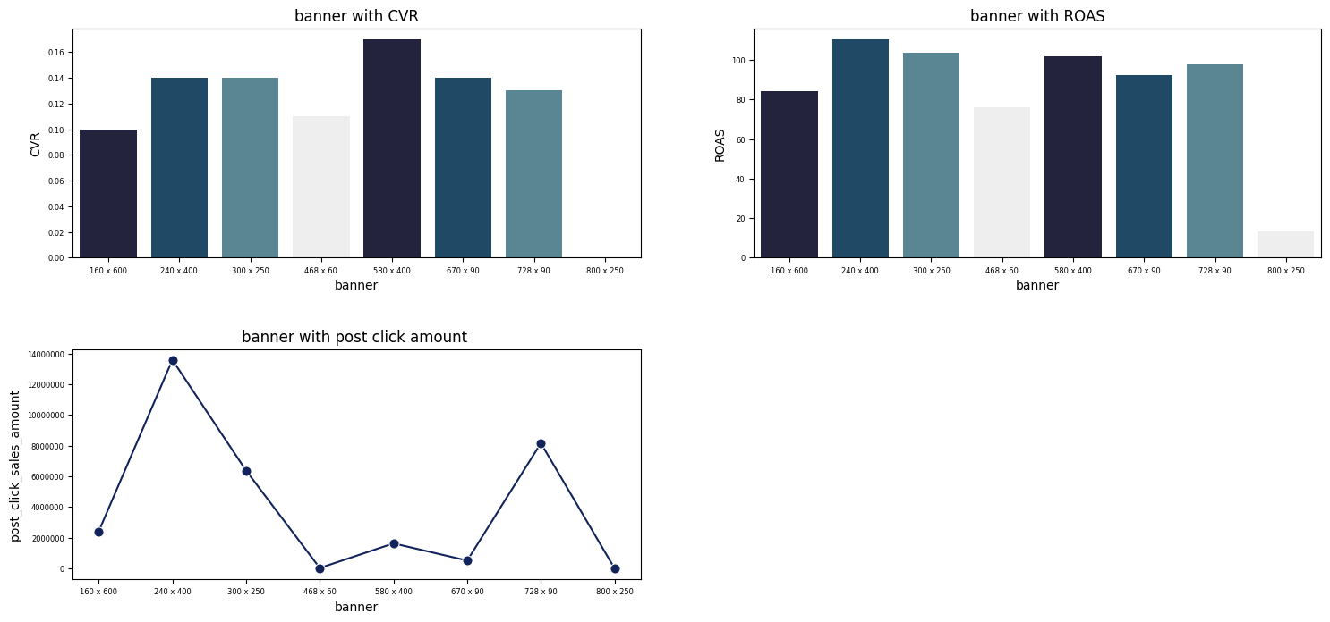
Post-click conversions are heavily concentrated in a small number of high-quality placements (notably ghi and mno), demonstrating that placement effectiveness matters far more than sheer exposure. While several placements generate visibility, only a few translate that visibility into meaningful conversions, indicating clear budget leakage. Reallocating spend toward these high-converting placements and reducing investment in low-performing ones can significantly improve ROI without increasing overall cost.
A small set of standard banner sizes (notably 240×400 and 728×90) consistently deliver strong conversion rates, high return on ad spend, and the majority of post-click revenue –proving that format selection, not creative volume, is the primary driver of campaign profitability.

Slide 14
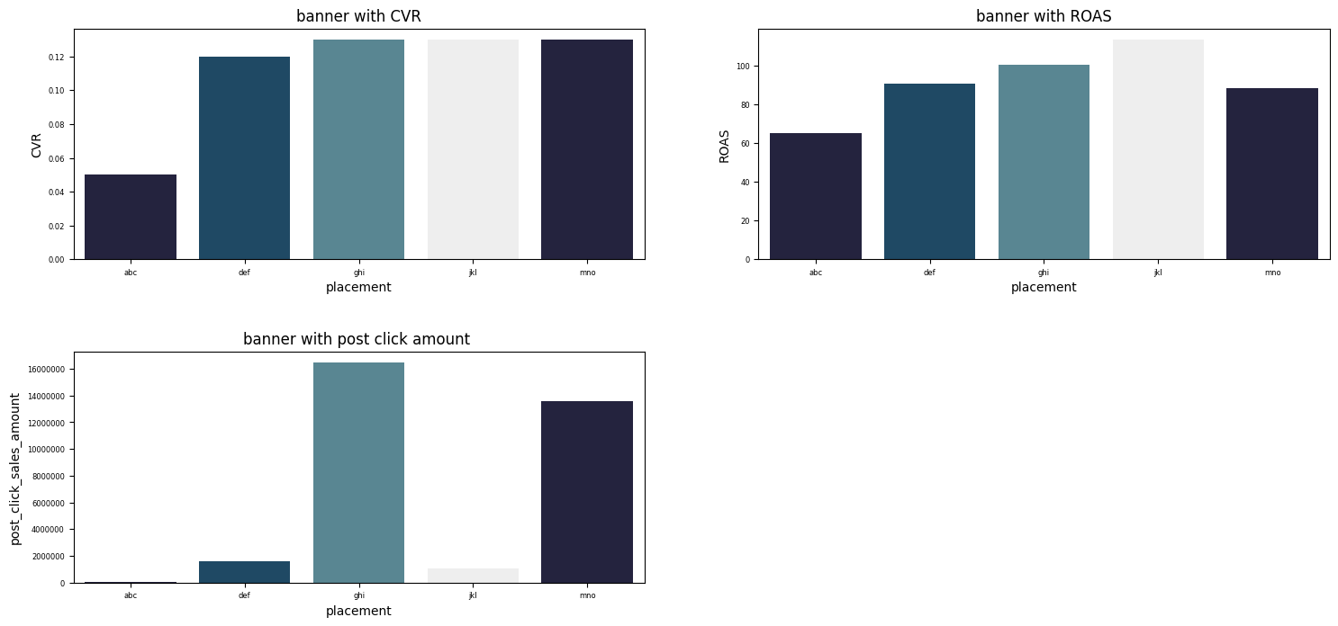
Placements ghi and mno consistently outperform others across the entire funnel-showing high conversion rates, strong return on ad spend, and the largest share of post-click revenue-demonstrating that a small number of high-quality placements drive the majority of campaign profitability. In contrast, some placements achieve reasonable conversion or ROAS but fail to scale revenue, highlighting that true success lies in placements that balance efficiency with volume.
A few placements dominate conversions, ROI, and revenue, making placement selection the single most important lever for campaign profitability.

Slide 15
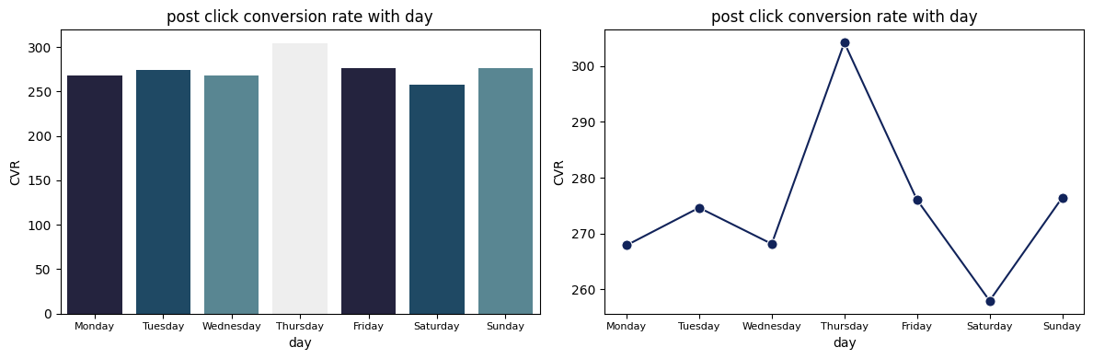
Conversion rates consistently peak on mid-to-late weekdays (especially Thursday and Friday) across all three months, while weekends-particularly Saturday-underperform, indicating that user intent and purchase readiness are strongest during the working week rather than leisure periods.
Post-click conversion rates consistently peak on Thursdays, with strong performance on adjacent weekdays, while Saturdays show the lowest conversion intent—indicating that user readiness to convert is highest during the mid-week working cycle and drops sharply during weekends.

Slide 16
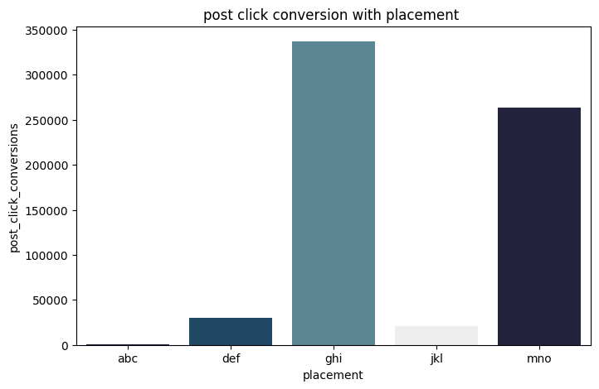
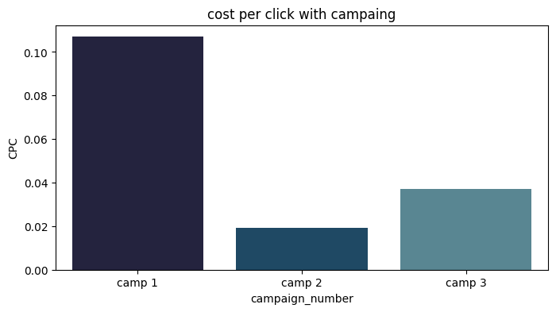
Post-click conversions are extremely concentrated in placements ghi and mno, showing that only a small subset of placements meaningfully drive customer actions, while others contribute negligible conversion value.
Campaign 1 has a significantly higher cost per click than Campaigns 2 and 3, indicating that its superior performance is driven by higher-quality or more competitive traffic rather than cheaper acquisition.
Placements ghi and mno consistently outperform across the entire funnel-delivering high conversion rates, strong return on ad spend, and the majority of post-click revenue—showing that a small number of high-quality placements drive most campaign profitability. In contrast, some placements achieve decent CVR or ROAS but fail to scale revenue, proving that true performance requires both efficiency and volume.

Slide 17
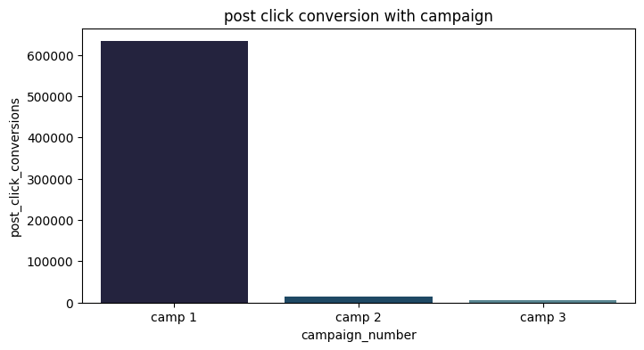
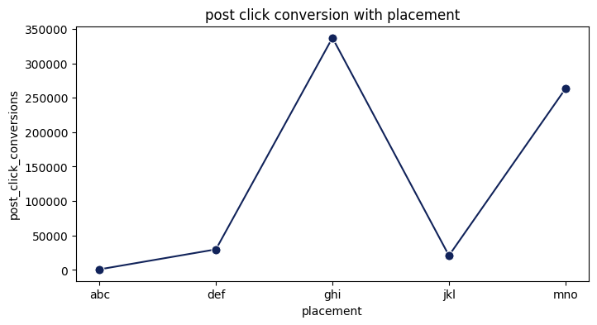
Campaign 1 overwhelmingly drives post-click conversions compared to Campaigns 2 and 3, showing that conversion success is primarily driven by campaign strategy quality rather than campaign count or frequency.
Post-click conversions are heavily concentrated in a few placement - especially ghi and mno- while other placements contribute minimal conversion value, indicating strong inefficiency in broad placement distribution.

Slide 18
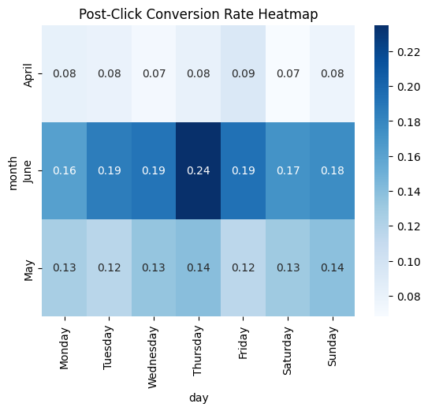
Across all months, Thursday consistently shows the highest post-click conversion rates, with a pronounced peak in June, indicating strong mid-week user purchase intent.
Conversion rates increase significantly from April to June, especially on weekdays, suggesting stronger market readiness or improved campaign effectiveness in later months.
Conversion performance is driven more by day-of-week patterns than by random daily variation, as the same high- and low-performing days repeat consistently across months.
Weekday conversion rates are uniformly stronger than weekends, suggesting that user purchase intent is closely tied to structured routines rather than leisure browsing.

Slide 19
MEDIA SECTOR

Slide 20
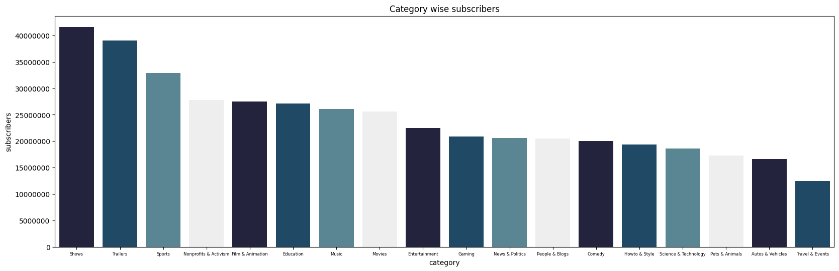
Shows, Trailers, and Sports categories attract the highest subscriber counts, indicating that mass-entertainment and recurring content drive long-term audience accumulation on YouTube.
Education, Music, Movies, and Entertainment form a strong middle tier, showing that informational and semi-entertainment content can scale, but not as aggressively as pure entertainment.
Categories like Science & Technology, Pets & Animals, and Autos & Vehicles show lower subscriber totals, suggesting niche audience caps rather than poor content performance.

Slide 21
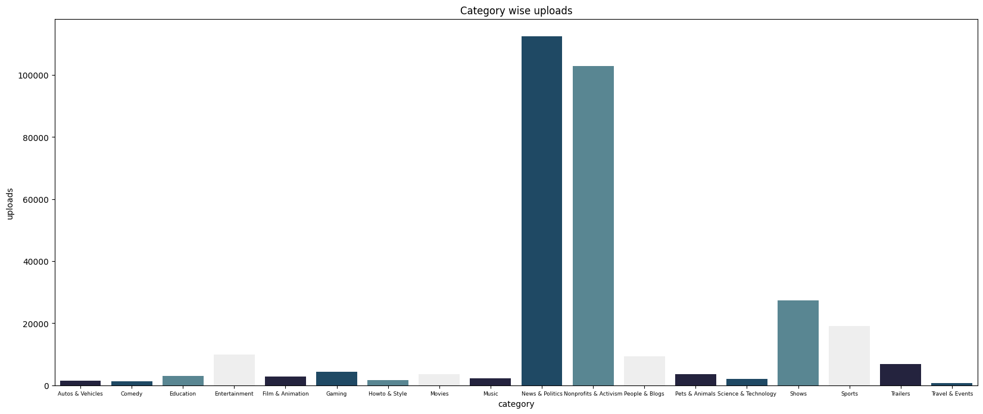
Subscriber growth on YouTube is driven by content efficiency rather than content volume: categories like Shows, Sports, and Trailers achieve massive audiences with fewer uploads, while high-volume categories such as News & Politics fail to translate frequent posting into equivalent subscriber scale, proving that repeat appeal and entertainment value matter more than sheer quantity.
News & Politics and Nonprofits & Activism have an exceptionally high number of uploads compared to all other categories, indicating a content-heavy, high-frequency publishing model.

Slide 22
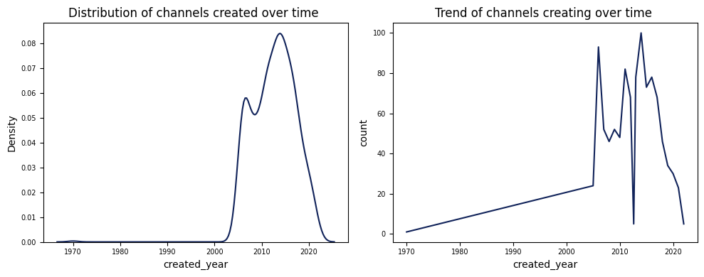
Channel creation peaks between 2010 and 2016, after which a clear decline is visible, suggesting market saturation and increased competition barriers for new creators.
The majority of top channels were created after 2008, indicating that YouTube’s creator ecosystem scaled rapidly once the platform matured and monetization became viable.
Sharp spikes and drops in channel creation indicate sensitivity to external factors such as algorithm changes, monetization policies, and creator economy cycles.
Most successful YouTube channels emerged during a short high-growth window, and creator entry has since slowed due to saturation and rising competition.

Slide 23
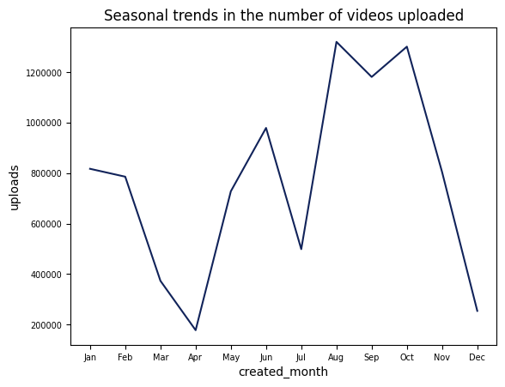
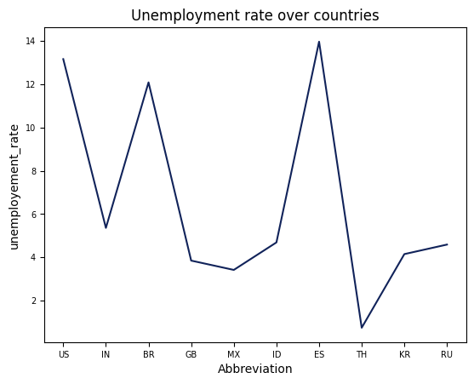
Video uploads peak during late summer and early autumn (August–October) and drop sharply in early spring and December, indicating strong seasonality in creator activity.
The sharp rise after April suggests creators strategically ramp up content ahead of peak consumption months rather than uploading evenly throughout the year.
Unemployment rates vary significantly across countries, highlighting unequal economic conditions that can influence creator motivation, platform participation, and content production.
Countries with higher unemployment rates may see stronger incentives for digital content creation as alternative income sources, reinforcing YouTube’s role in the creator economy.

Slide 24
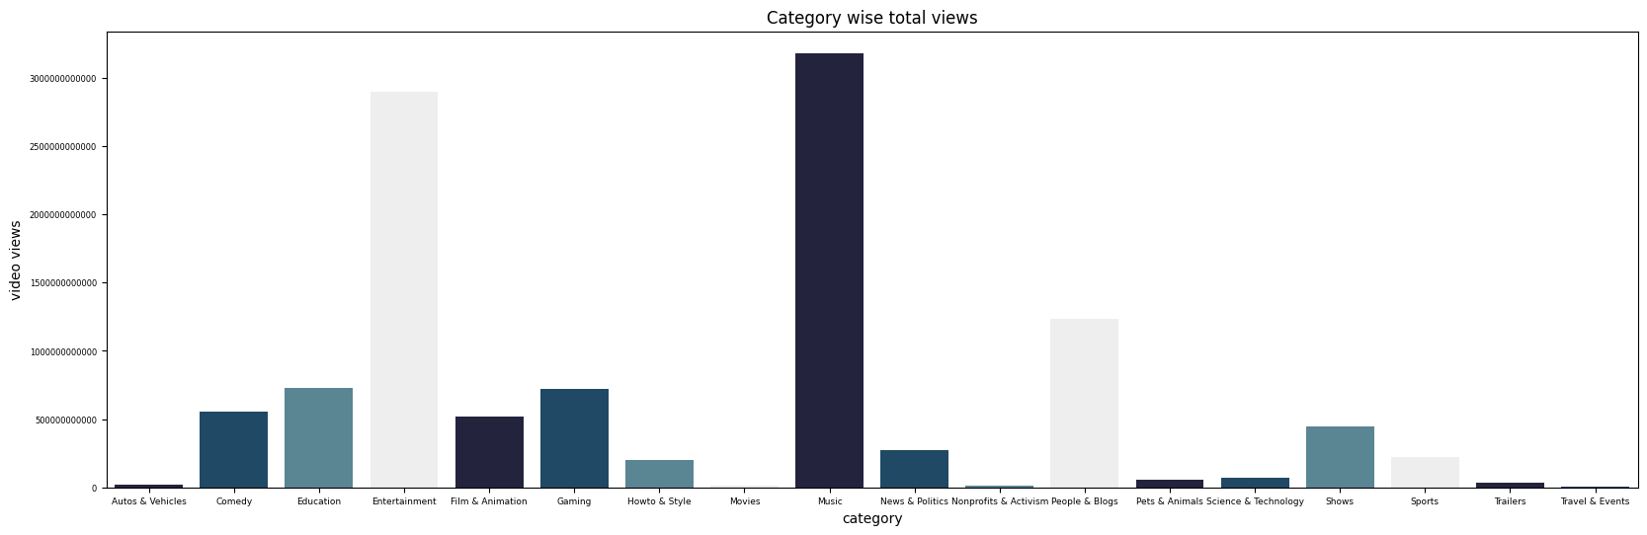
Total video views are heavily concentrated in entertainment-driven categories such as Music, Entertainment, and People & Blogs, confirming that long-term watch time—not upload volume—drives platform dominance. While categories like News & Politics produce extremely high content volume, they fail to generate comparable viewership, whereas Music and Entertainment achieve massive views with relatively fewer uploads, highlighting superior content efficiency and repeat consumption behavior.

Slide 25
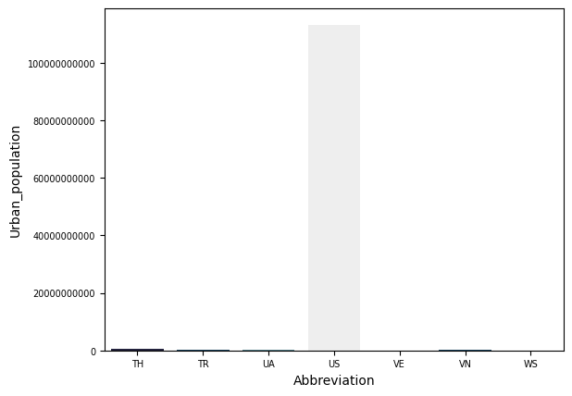
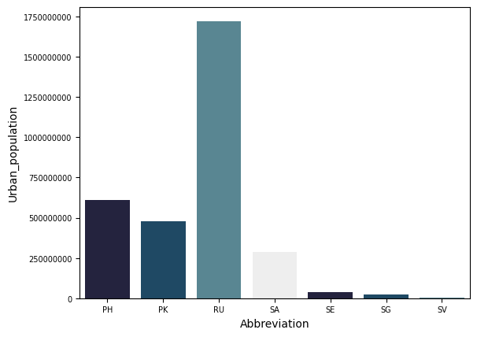
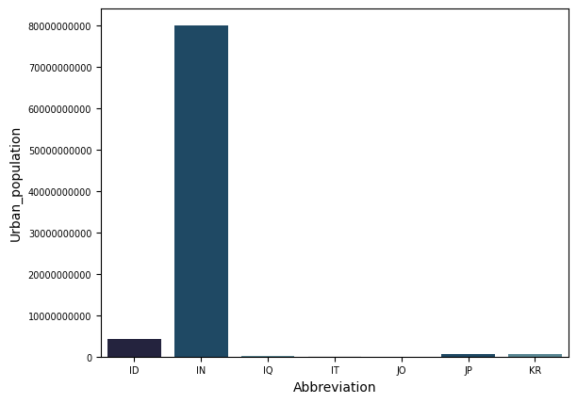
A small number of countries (notably the US, India, Brazil, Russia, and Mexico) dominate global urban population, while most countries contribute marginally.
Countries like India, Brazil, Mexico, and Indonesia combine large urban populations with growing digital adoption, making them high-growth markets for content creation and platform expansion.
Several highly urbanized but smaller countries show limited total urban population, indicating that market size-not just urbanization rate-drives creator scale potential.
The uneven distribution of urban population helps explain why top creators and high-earning channels are disproportionately concentrated in a few countries.

Slide 26
THANK YOU !!

